Slide 1
Active Learning with Low-Rank Structure for Data Selection
Vincent Cohen-Addad
Sasidhar Kunapuli
Mahdi Nikdan
Vahab Mirrokni
David P. Woodruff
Samson Zhou

Slide 2
The Cost of Scale in Machine Learning
Training/fine-tuning foundation models is expensive.
Goal: select a small representative coreset.
Traditional active learning requires scoring the entire dataset.
Batch methods often select redundant samples.

Slide 3
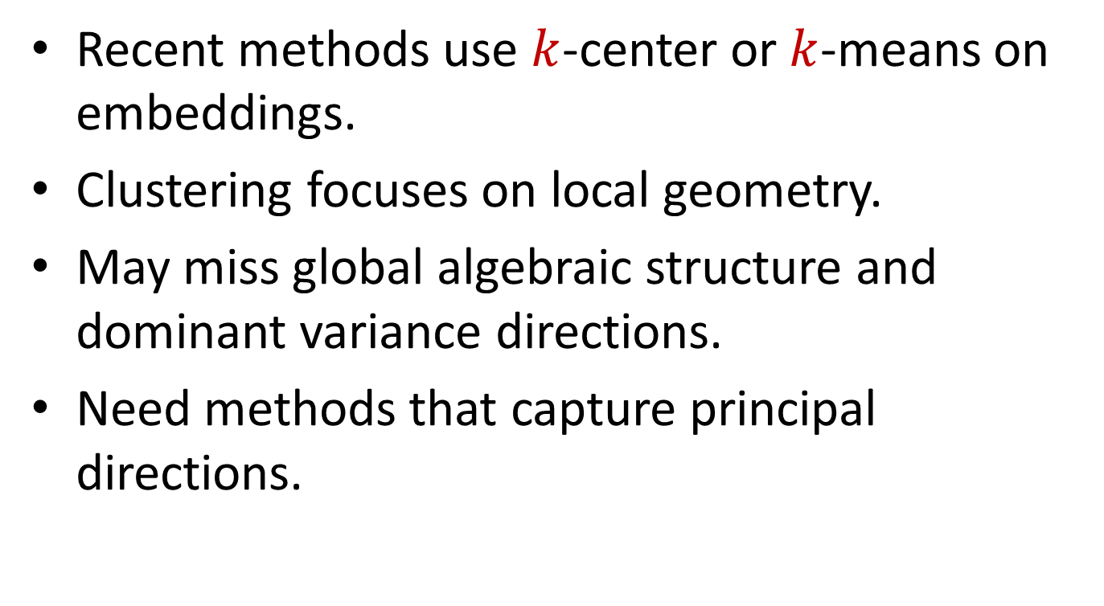
Why Clustering Falls Short in High Dimensions
Recent methods use $k$-center or $k$-means on embeddings.
Clustering focuses on local geometry.
May miss global algebraic structure and dominant variance directions.
Need methods that capture principal directions.

Slide 4
Moving from Distance to Direction
Prioritize dominant spectral directions.
Low-rank approximations retain critical components.
Connection to LoRA: exploit low-rank structure.
Capture informative training examples via algebraic structure.

Slide 5
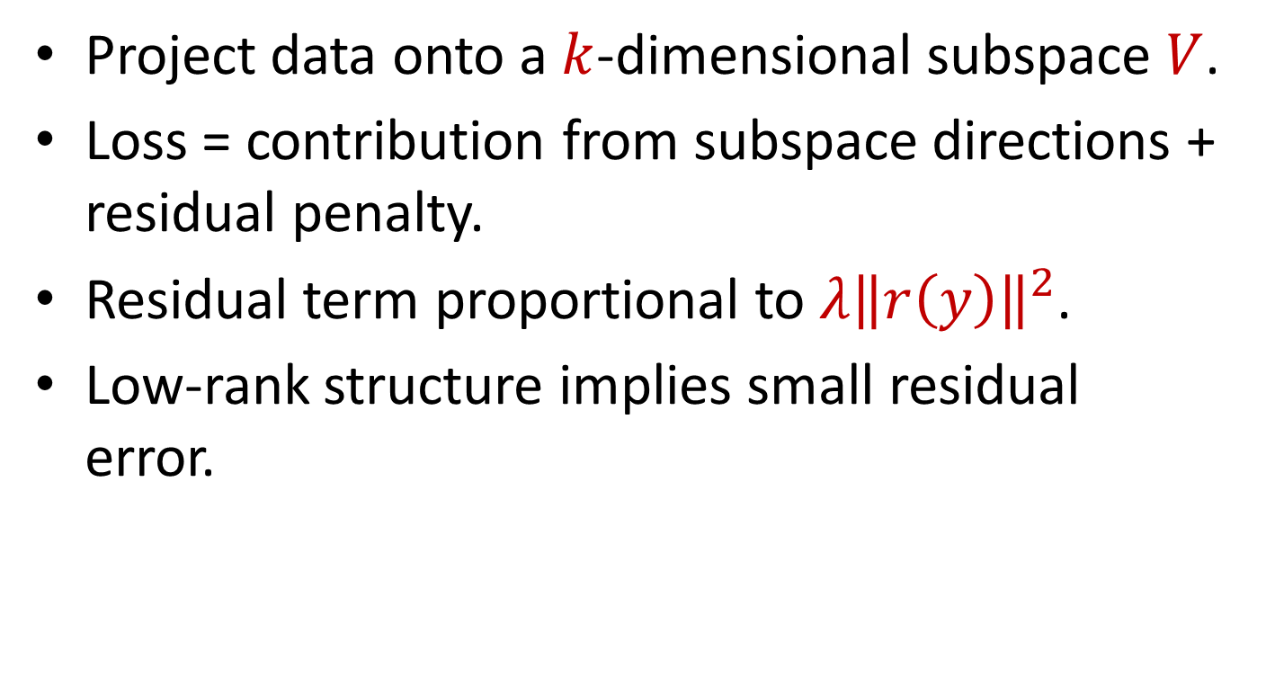
Decomposing the Loss Function
Project data onto a $k$-dimensional subspace $V$.
Loss = contribution from subspace directions + residual penalty.
Residual term proportional to $λ{\left\|r\left(y\right)\right\|}^{2}$.
Low-rank structure implies small residual error.

Slide 6
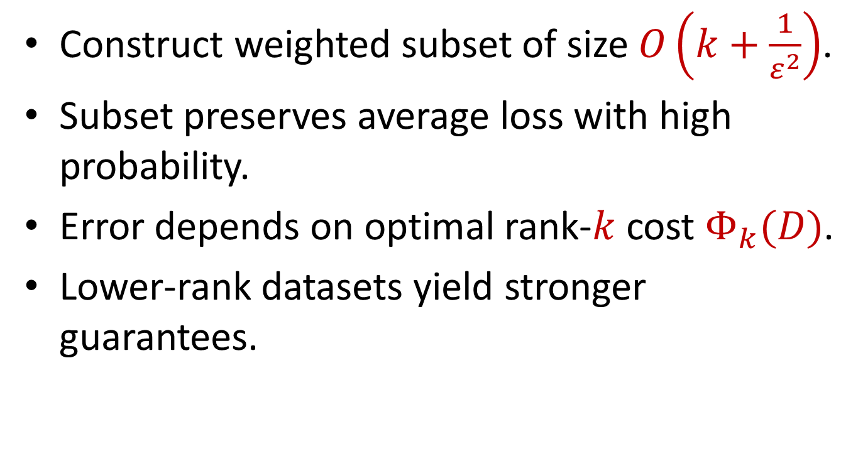
Provable Coresets for Loss Approximation
Construct weighted subset of size $O\left(k+\frac{1}{ε^{2}}\right)$.
Subset preserves average loss with high probability.
Error depends on optimal rank-$k$ cost $Φ_{k}(D)$.
Lower-rank datasets yield stronger guarantees.

Slide 7
Low-Rank Sensitivity Sampling
1. Compute low-rank basis from embeddings.
2. Compute projections and residuals.
3. Calculate sensitivity scores.
4. Sample proportionally and apply inverse-probability weights.

Slide 8
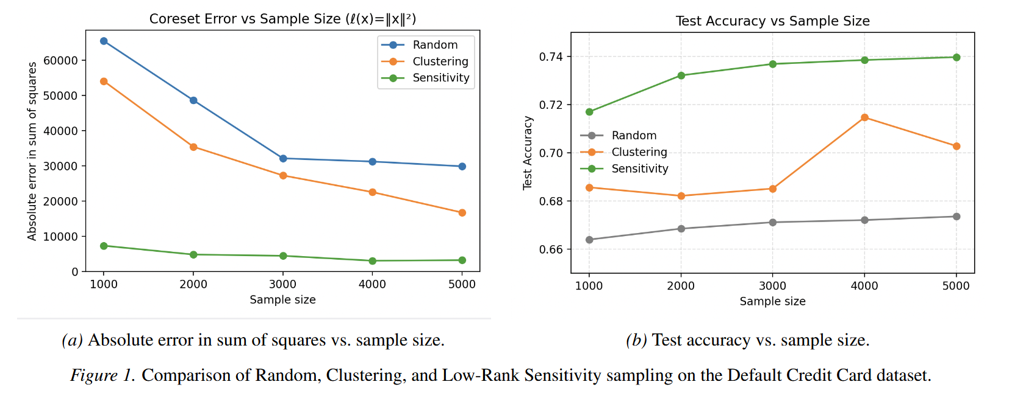
Empirical Validation: Credit Card Default
Compared with random sampling and k-means.
Much lower coreset approximation error.
Higher downstream logistic-regression accuracy.
Outperforms clustering and random baselines.

Slide 9
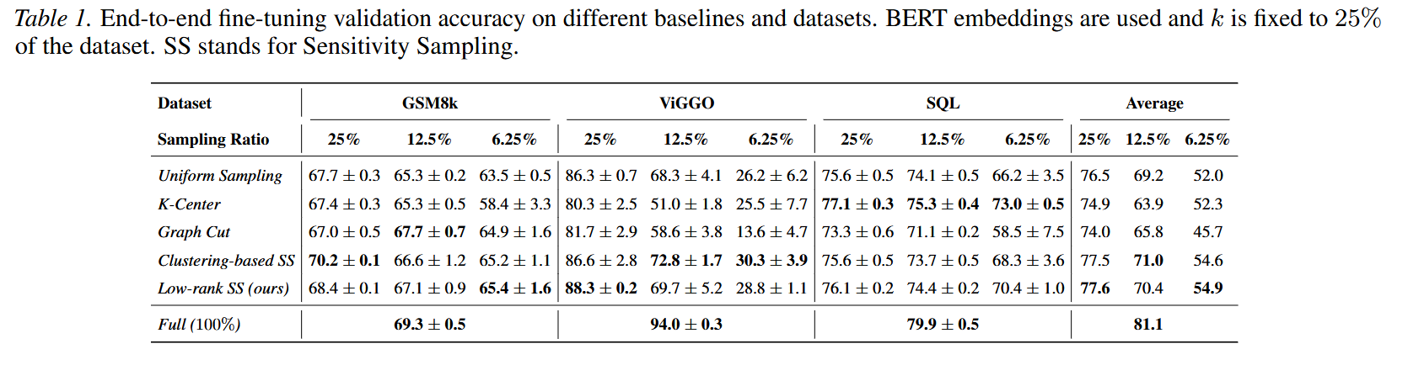
Scaling Up: LLM Fine-Tuning
Models: Llama3-8B and Qwen2.5-3B.
Tasks: GSM8K, ViGGO, SQL generation.
Uses only 6.25%-25% of training data.
Consistently beats clustering and graph-cut baselines.

Slide 10
Transferability Across Models
Data selected with Llama3 embeddings transferred to Qwen.
Transferred subsets outperform native selections.
Captures intrinsic dataset structure.
Not tied to model-specific artifacts.

Slide 11
Summary & Impact
Shifts data selection from geometry to low-rank structure.
Provides strong theoretical guarantees.
Efficient and scalable for modern LLMs.
Delivers superior empirical performance.

